Slide 1


Jing Yu
01/25/2023

Slide 2

Outline
Executive Summary
Introduction
Methodology
Results
Conclusion
Appendix

Slide 3
Executive Summary
Summary of methodologies
Data collection and wrangling methodology
EDA and interactive visual analytics methodology
Predictive analysis methodology
Summary of all results
EDA with visualization results
EDA with SQL results
Interactive map with Folium
Plotly Dash
Predictive analysis results

Slide 4
Introduction
Project background and context
The commercial space age is here, companies are making space travel affordable for everyone. The most successful is SpaceX as its rocket launches are relatively inexpensive. Unlike other rocket providers, SpaceX's Falcon 9 can recover the first stage.
As data scientists, we are going to analyze the Falcon 9 reuse of SpaceX and evaluate if a new rocket company, Space Y, could bid against SpaceX and compete.
Problems you want to find answers
What are the key features to determine the price of each launch?
What influence the success rate of the Falcon 9 launch?
Where is the best launch site to achieve the largest success?
Could we predict the launch success by machine learning method?

Slide 5
Methodology
Executive Summary
Data collection methodology:
Request from SpaceX API
Web Scraping from Wikipedia
Perform data wrangling
Filter data to only include Falcon 9 launches
Cleanse data to deal with the missing values
Determine training labels
Perform exploratory data analysis (EDA) using visualization and SQL
Perform interactive visual analytics using Folium and Plotly Dash
Perform predictive analysis using classification models
Transform data set and split into training and testing data
Train different models to find the best parameters and best score

Slide 6

Section 1

Slide 7
Data Collection – SpaceX API
Data collected from SpaceX API (https://api.spacexdata.com/v4/launches/past)
Request and parse the SpaceX launch data from API_call_spacex_api.json
Request rocket launch data from SpaceX API
Decode the response content as a Json using .json() and turn it into a dataframe using .json_normalize()
Replace missing values with calculated mean
Filter the dataframe to only include Falcon 9 launches
Apply helper functions to extract information and form a dataframe
Export it to a CSV for the next section
Applied-Data-Science-Capstone/Data Collection with API.ipynb at master · rowlland/Applied-Data-Science-Capstone · GitHub

Slide 8
Data Collection - Scraping
Perform web scraping to collect Falcon 9 historical launch records from Wikipedia
(https://en.wikipedia.org/wiki/List_of_Falcon\_9\_and_Falcon_Heavy_launches)
Export it to a CSV for the next section
Request the Falcon9 Launch Wiki page from its URL
Extract variable names from the HTML table header
Create a data frame by parsing the launch HTML tables
Create a BeautifulSoup object from the HTML response
Applied-Data-Science-Capstone/Data Collection with Web Scraping.ipynb at master · rowlland/Applied-Data-Science-Capstone · GitHub

Slide 9
Data Wrangling
Perform exploratory data analysis for the data collected from API
Determine training Labels
Determine the success rate
Calculate the number of launches on each site
Calculate the number and occurrence of each orbit
Calculate the number and occurence of mission outcome per orbit type
Create a landing outcome label from Outcome column
Export to a CSV for the next section
Applied-Data-Science-Capstone/Data Wrangling.ipynb at master · rowlland/Applied-Data-Science-Capstone · GitHub

Slide 10

EDA with Data Visualization
Use scatter chart to plot out:
Flight Number vs. Payload Mass
Flight Number vs. Launch Site
Payload vs. Launch Site
Flight Number vs. Orbit type
Payload vs. Orbit type
Create a bar chart to visualize:
Success rate of each orbit type
Plot a line chart to visualize:
Launch success yearly trend
Applied-Data-Science-Capstone/EDA with Visualization.ipynb at master · rowlland/Applied-Data-Science-Capstone · GitHub

Slide 11
EDA with SQL
Execute SQL queries to:
Display the names of the unique launch sites in the space mission
Display 5 records where launch sites begin with the string 'CCA'
Display the total payload mass carried by boosters launched by NASA (CRS)
Display average payload mass carried by booster version F9 v1.1
List the date when the first successful landing outcome in ground pad was achieved
List the names of the boosters success in drone ship and have payload mass 4000 to 6000
List the total number of successful and failure mission outcomes
List the names of the booster versions which have carried the maximum payload mass
List the failed landing outcomes in drone ship, their booster versions, and launch site names in 2015
Rank the count of landing outcomes between the date 2010-06-04 and 2017-03-20 descending
Applied-Data-Science-Capstone/EDA with SQL.ipynb at master · rowlland/Applied-Data-Science-Capstone · GitHub

Slide 12
Build an Interactive Map with Folium
Perform more interactive visual analytics using Folium:
Create a folium Map object
Use folium.Circle and folium.Marker to add each launch site on the site map
Use MarkerCluster to cluster the success(green)/failed(red) launches for each site on the map
Mark down proximity points using MousePosition and calculate the distance between the points and the launch site
Draw a PolyLine between a launch site to the selected proximity point
Applied-Data-Science-Capstone/Interactive Visual Analytics with Folium.ipynb at master · rowlland/Applied-Data-Science-Capstone · GitHub

Slide 13
Build a Dashboard with Plotly Dash
Build a Plotly Dash application to perform interactive visual analytics on SpaceX launch data in real-time
Create a dropdown menu to let us select different launch sites
Render a pie chart based on selected site to visualize launch success rate
Add a Range Slider to easily select different payload range
Plot a scatter chart to visually observe how payload may be correlated with mission outcomes for selected site(s)
Applied-Data-Science-Capstone/spacex_dash_app.py at master · rowlland/Applied-Data-Science-Capstone · GitHub

Slide 14
Predictive Analysis (Classification)
Create a machine learning pipeline to predict if the first stage will land
Fit the GridSearchCV object to find the best parameters for KNN, SVM, Classification Trees and Logistic Regression
Create a column for the class
Standardize the data
Split into training data and test data
Find the method performs best using test data
Calculate the accuracy on the test data and plot the confusion matrix for each method
Applied-Data-Science-Capstone/Machine Learning Prediction.ipynb at master · rowlland/Applied-Data-Science-Capstone · GitHub

Slide 15
Results
Executive Summary
Insights drawn from EDA
Launch Sites Proximity Analysis
Build a Dashboard with Plotly Dash
Predictive Analysis (classification)

Slide 16

Section 2

Slide 17
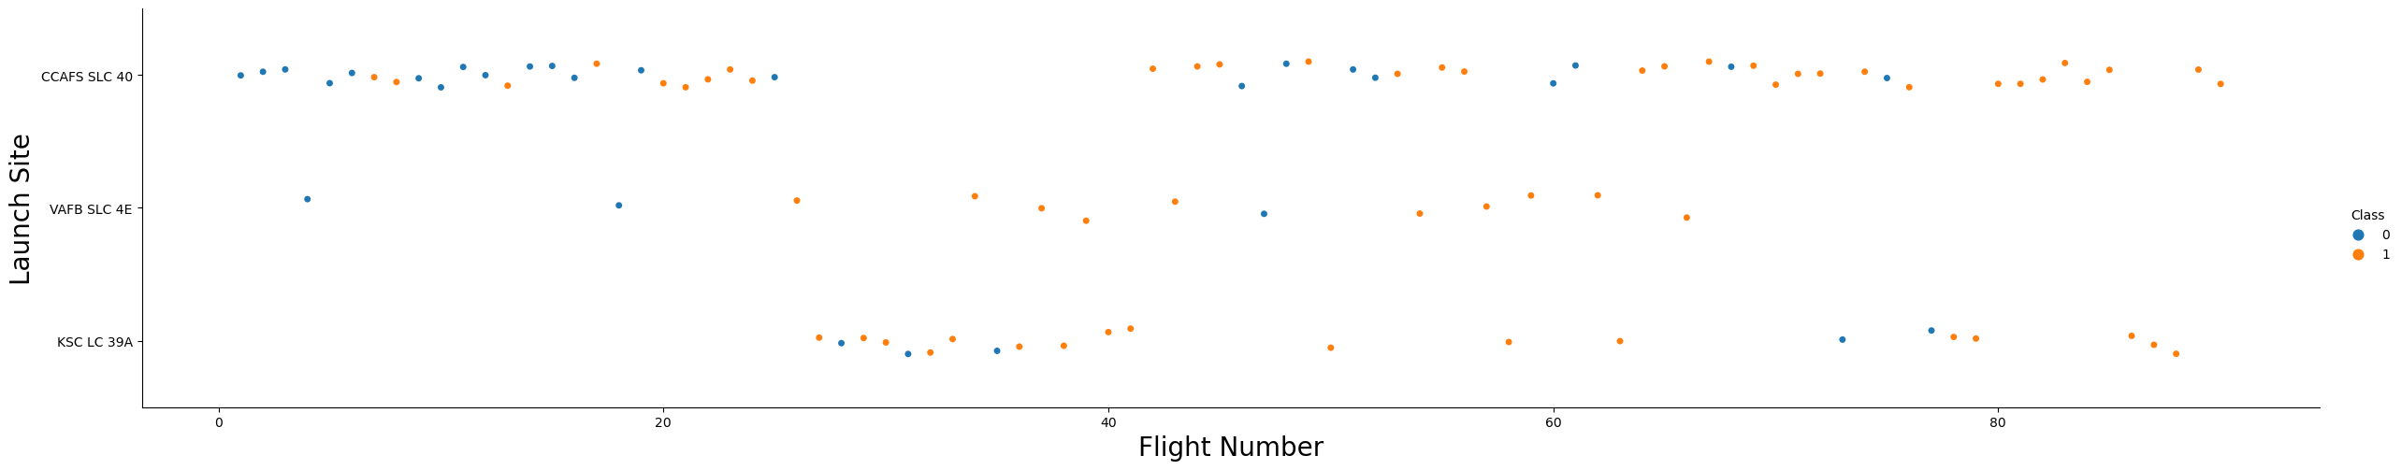
Flight Number vs. Launch Site
Explanations:
Most of the rockets were launched at CCAFS SLC 40. However, its success rate is lower.
As the flight number increases, the first stage is more likely to land successfully.

Slide 18
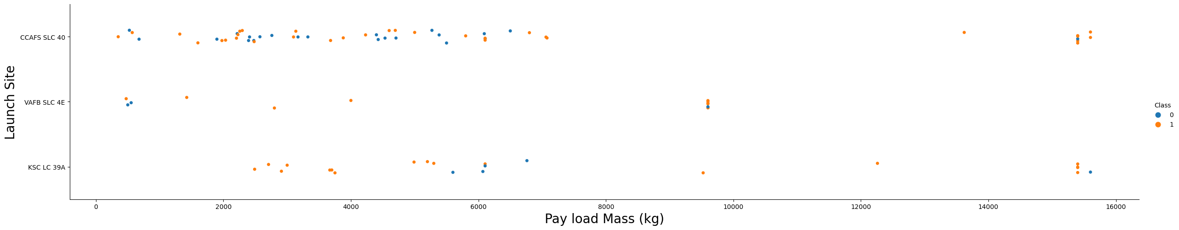
Payload vs. Launch Site
Explanations:
Most of the rockets were launched with payload mass under 8,000 kg.
No rockets launched for heavy payload mass(greater than 10,000) at VAFB-SLC.

Slide 19
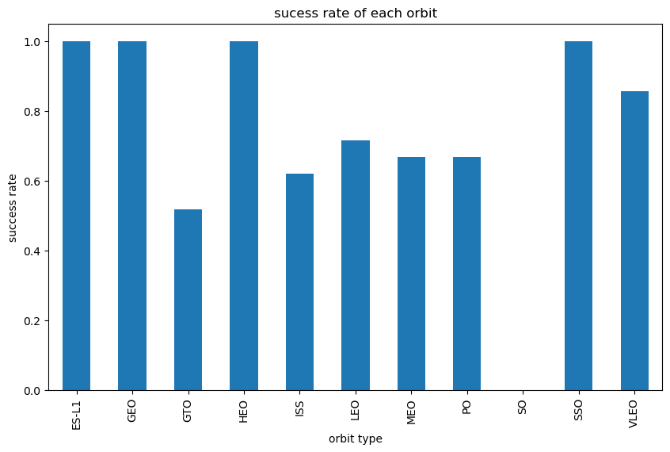
Success Rate vs. Orbit Type
Explanations:
In the ES-L1, GEO, HEO, SSO orbits, the success rates are 100%.
The SO orbit has the lowest success rate, 0%.

Slide 20
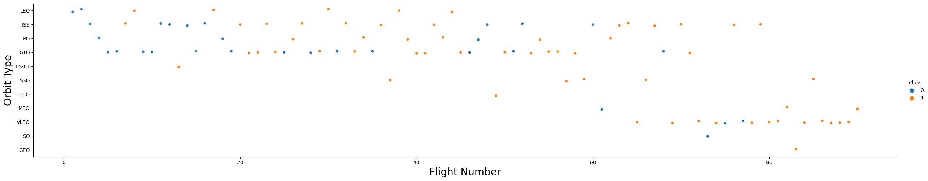
Flight Number vs. Orbit Type
Explanations:
In the LEO orbit the success appears related to the number of flights
There seems to be no relationship between flight number when in GTO orbit.

Slide 21
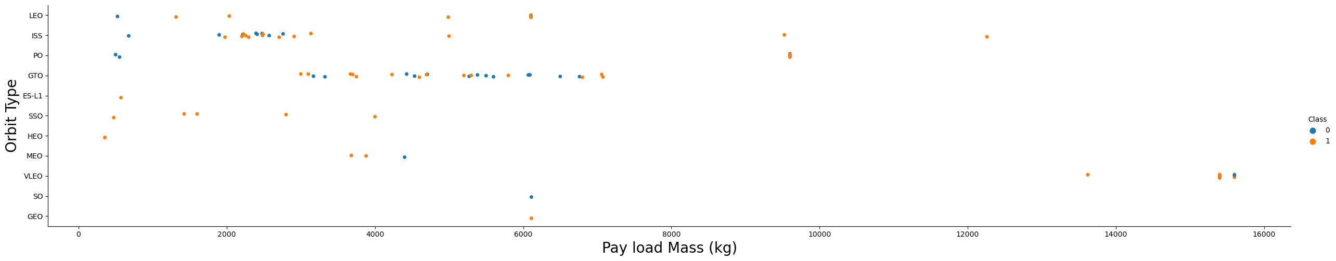
Payload vs. Orbit Type
Explanations:
With heavy payloads the successful landing rate are more for Polar, LEO and ISS.
For GTO we cannot distinguish this relationship well as both positive landing rate and negative landing(unsuccessful mission) are both there here.

Slide 22
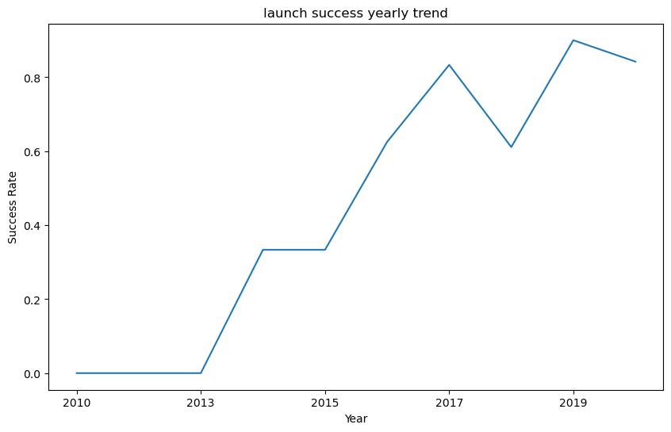
Launch Success Yearly Trend
Explanations:
The success rate since 2013 kept increasing till 2020.

Slide 23
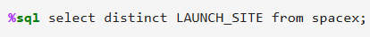
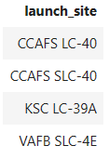
All Launch Site Names
The names of the unique launch sites

Slide 24
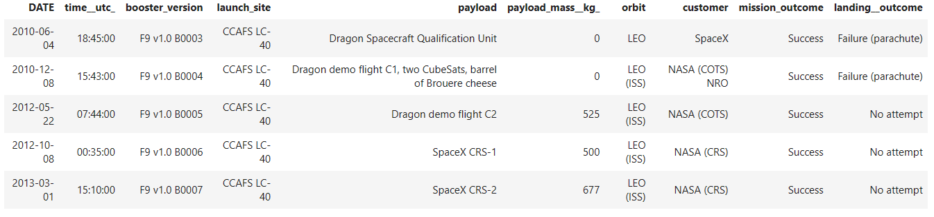
Launch Site Names Begin with 'CCA'
Find 5 records where launch sites begin with `CCA`

Slide 25
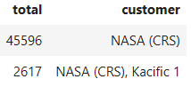
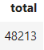
Total Payload Mass
The total payload carried by boosters from NASA (CRS): 48,213 KG

Slide 26
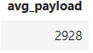
Average Payload Mass by F9 v1.1
The average payload mass carried by booster version F9 v1.1: 2,928 KG

Slide 27
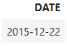
First Successful Ground Landing Date
The dates of the first successful landing outcome on ground pad:
2015-12-22

Slide 28
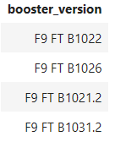
Successful Drone Ship Landing with Payload between 4000 and 6000
List the names of boosters which have successfully landed on drone ship and had payload mass greater than 4000 but less than 6000

Slide 29
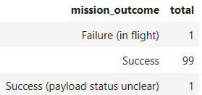
Total Number of Successful and Failure Mission Outcomes
Calculate the total number of successful and failure mission outcomes
Success 100
Failure 1

Slide 30
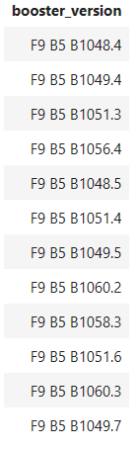
Boosters Carried Maximum Payload
List the names of the booster which have carried the maximum payload mass

Slide 31
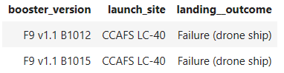
2015 Launch Records
List the failed landing outcomes in drone ship, their booster versions, and launch site names for in year 2015

Slide 32
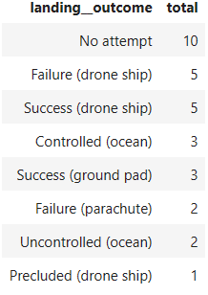
Rank Landing Outcomes Between 2010-06-04 and 2017-03-20
Rank the count of landing outcomes (such as Failure (drone ship) or Success (ground pad)) between the date 2010-06-04 and 2017-03-20, in descending order

Slide 33

Section 3

Slide 34

All Launch Sites on a Map
All launch sites are in proximity to the Equator line.
All launch sites are in very close proximity to the coast.

Slide 35
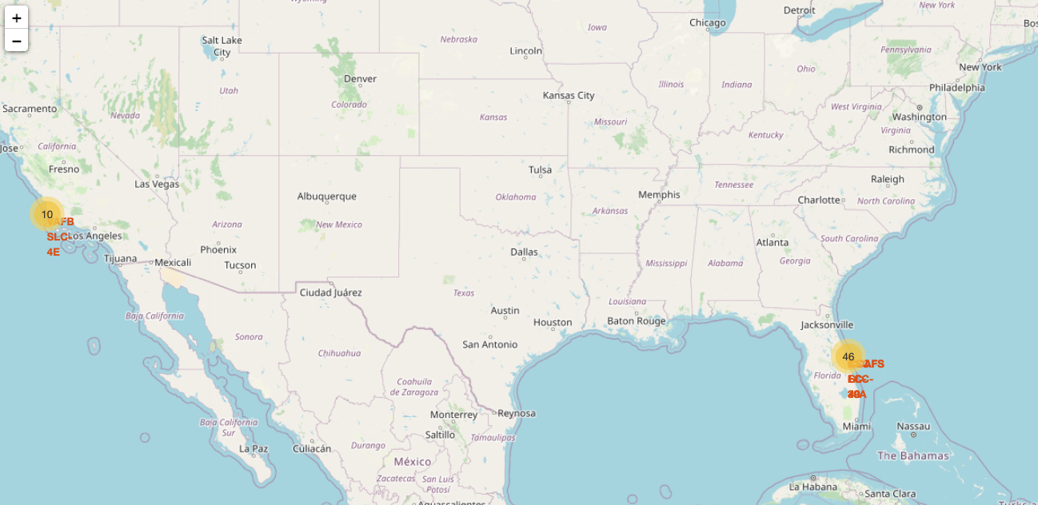
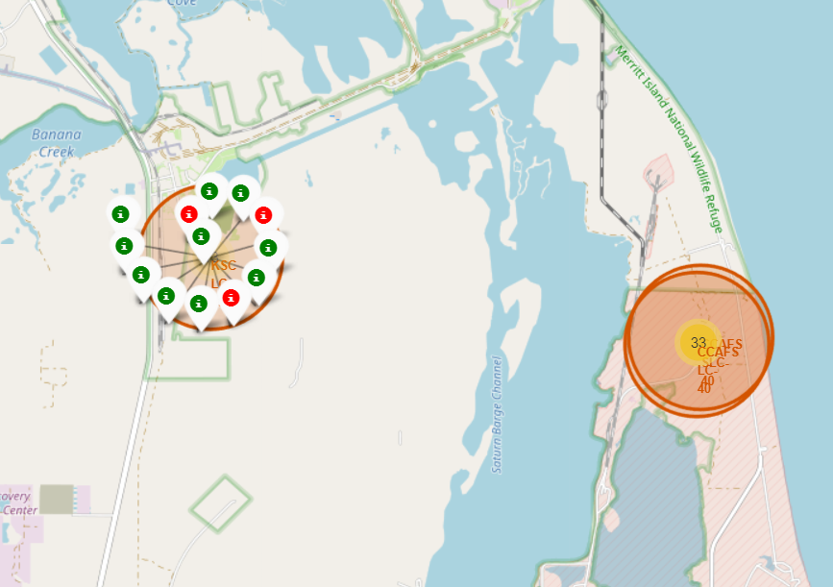
Success/Failed Launches for Each Site on the Map
The color-labeled markers in marker clusters: success as green, failure as red.
We could easily identify:
CCAFS LC-40 have most launches
KSC LC-39A sites have relatively higher success rates

Slide 36
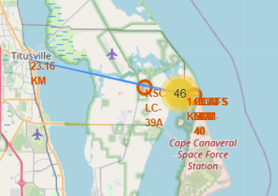
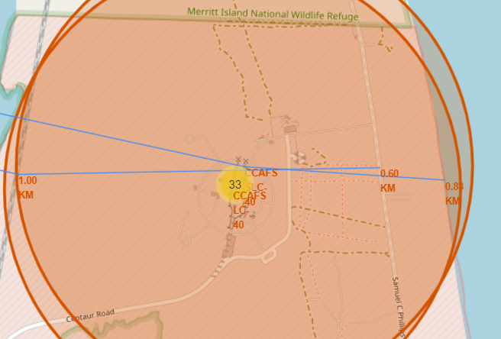
Distances Between a Launch Site to Proximities
Select CCAFS SLC-40 as an example:
Its proximities such as railway, highway, coastline are within 1-km distance for convenient transportation
The closest city, Titusville, is 23.16 km away as failed launches could be dangerous in populated areas

Slide 37

Section 4

Slide 38
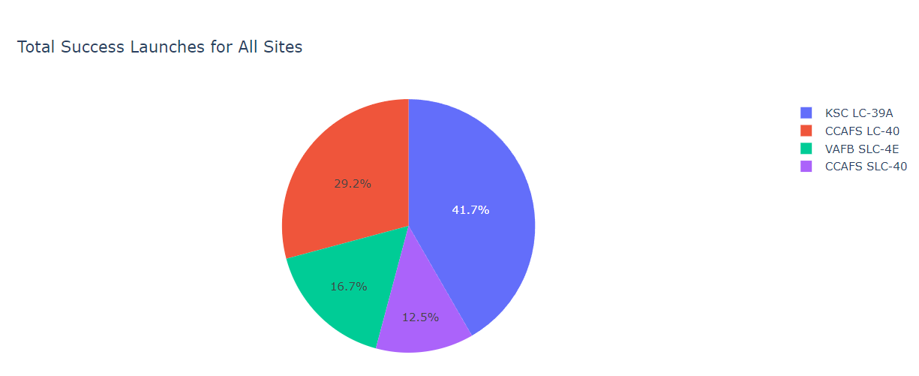
Total Success Launches for All Sites
KSC LC-39A has the highest success rate among all sites
CCAFS SLC-40 has the lowest success rate.

Slide 39
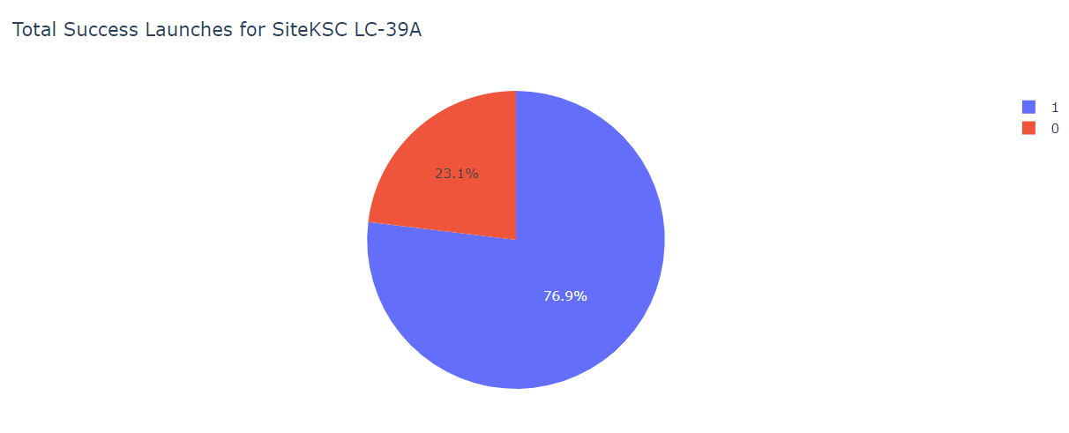
Launch Site with Highest Launch Success Ratio
KSC LC-39A has the success rate of 76.9%.

Slide 40
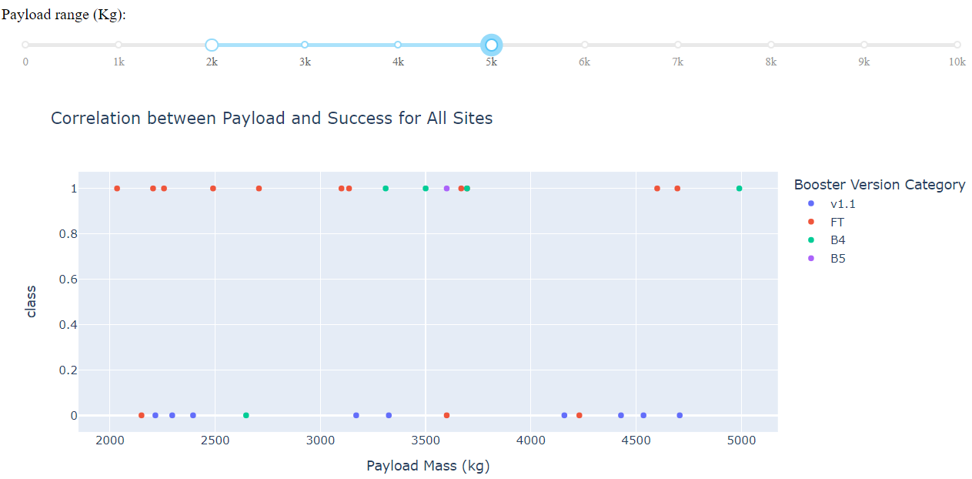
Payload vs. Launch Outcome for All Sites
Most launches are with payload mass between 2,000 to 5,000 KG
FT booster has the highest success ratio within payload range of 2,000 to 5,000 KG
Most launches with v1.1 booster are failed within payload range of 2,000 to 5,000 KG

Slide 41
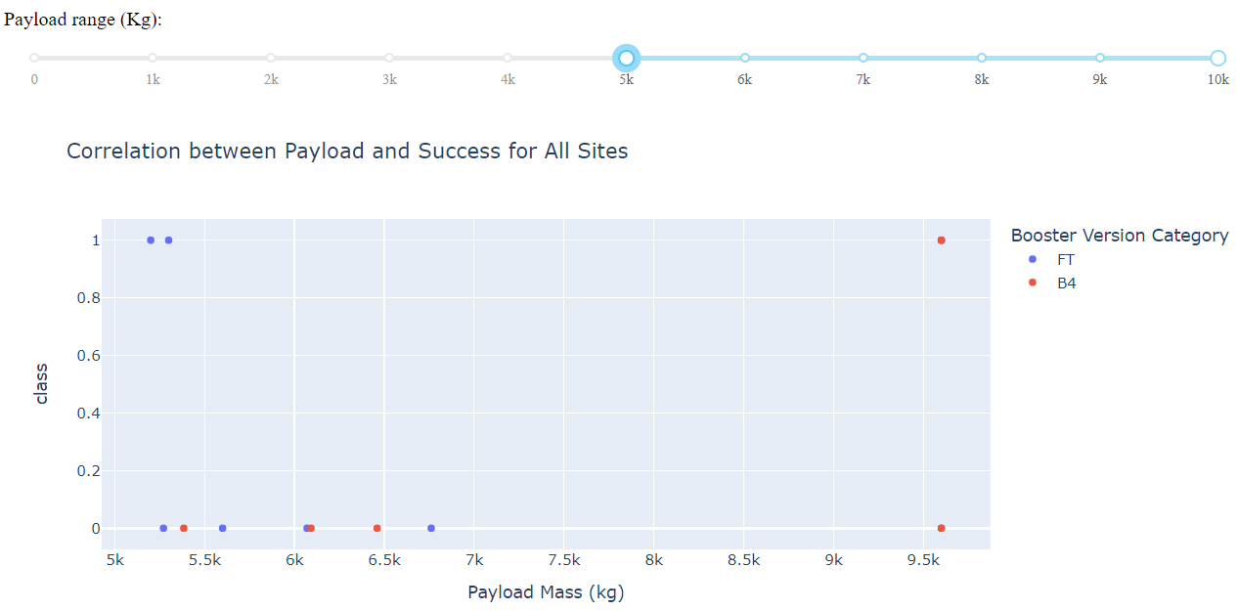
Heavy Payload vs. Launch Outcome for All Sites
With payload mass above 5,000 KG, the first stage is less likely to land successfully
Only FT and B4 booster launch with heavy load above 5,000 KG

Slide 42

Section 5

Slide 43
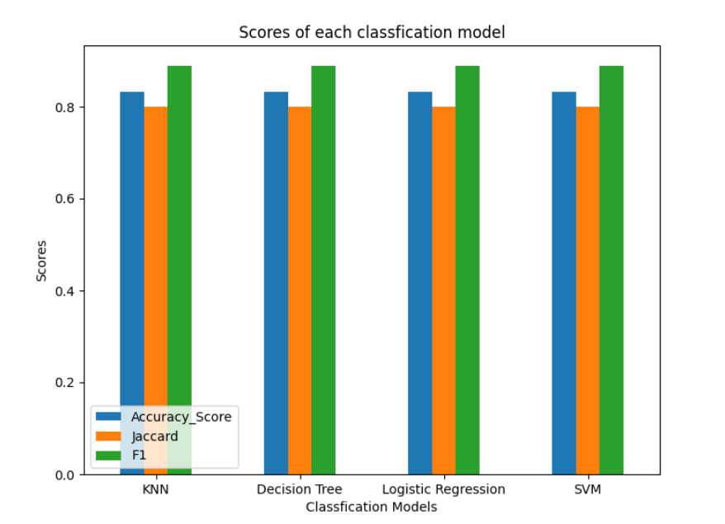
Classification Accuracy with test size 20%
We split the data X and Y into training and test data. Set the parameter test_size to 0.2 and random_state to 2
We train four classification models including KNN, Decision Tree, Logistic Regression and SVM based on the training data and get the scores based on the test data
From the bar chart, we can hardly find a better method to predict the target 'Class'. One reason is that the test set has only 18 samples.

Slide 44
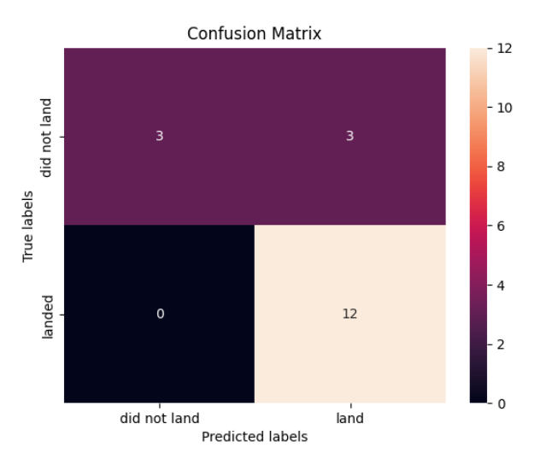
Confusion Matrix with test size 20%
The built classification models have similar confusion matrix based on the test data
From the confusion matrix, the major issue is the false positive which is the upper left part
To find a better model, we need to expand the test data.

Slide 45
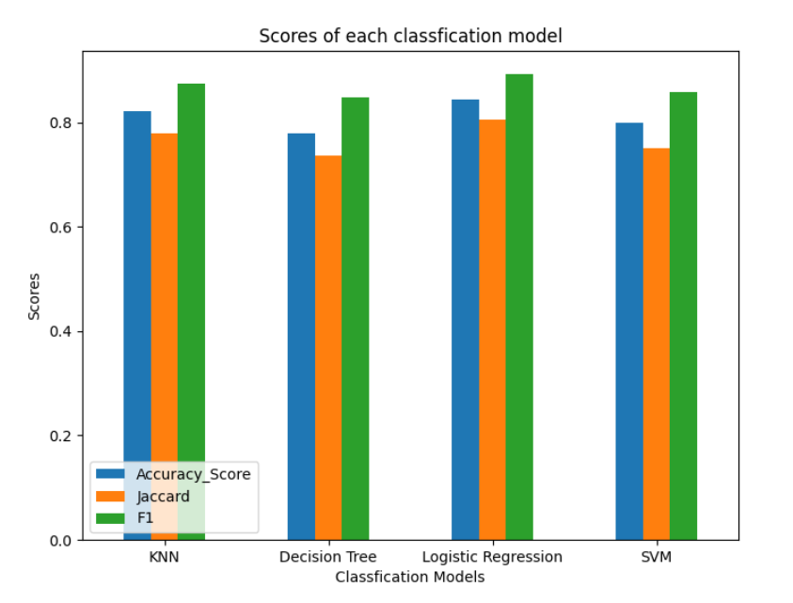
Classification Accuracy with test size 50%
We reset the test_size to 0.5, keep the random_state as 2
We train four classification models including KNN, Decision Tree, Logistic Regression and SVM based on the training data and get the scores based on the test data
From the bar chart, we can find logistic Regression has all the scores higher than other models

Slide 46
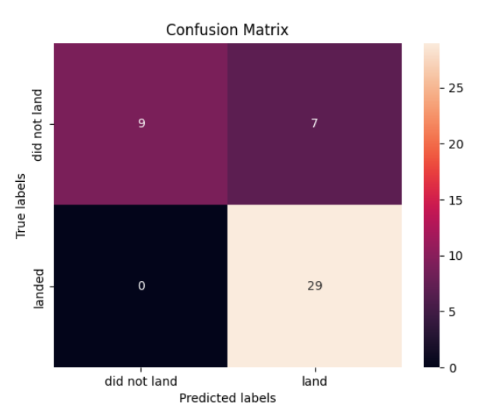
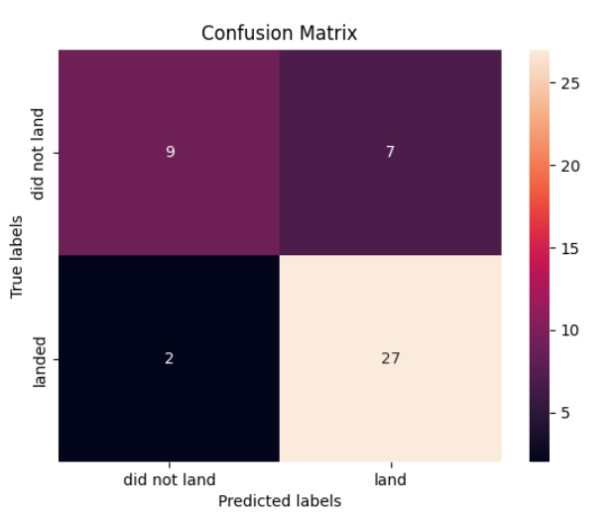
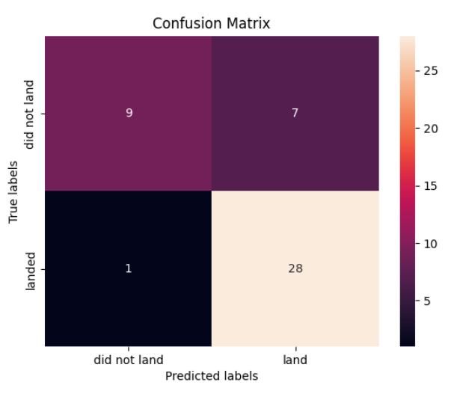
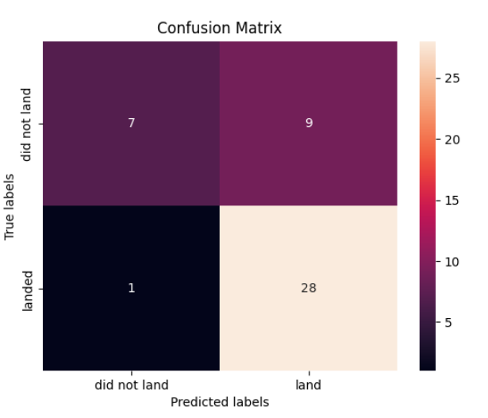
Confusion Matrix with test size 50%
The Logistic Regression model has a better confusion matrix based on the test data
From the confusion matrix, the major issue is still the false positive part
Logistic Regression
SVM
KNN
Decision Tree

Slide 47
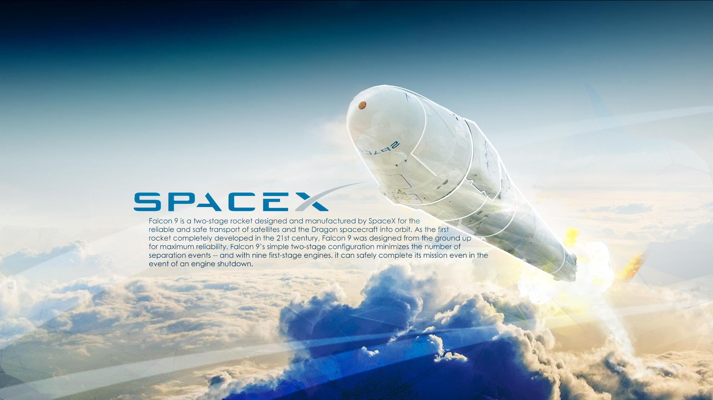
Conclusions
To determine the price of each launch, some key features are payload mass, orbit type, launch site, booster version
The success rate is increasing based on the yearly trend
With 2,000 to 5,000 KG payload, the first stage is more likely to land successfully
KSC LC-39A has the highest success rate among all sites
FT booster has the highest success rate
ES-L1, GEO, HEO, SSO orbits have success rates of 100%
The launch site should be close to highway, railway or coastline, away from populated areas
Based on our data, Logistic Regression is a better classification model to predict the successful landing of Falcon 9

Slide 48
Appendix
Dashboard:
https://github.com/rowlland/Applied-Data-Science-Capstone/tree/master/dash%20screenshot
Folium maps:
https://github.com/rowlland/Applied-Data-Science-Capstone/tree/master/folium%20maps

Slide 49


